Slide 1
Chapter Five
Choice

Slide 2
Economic Rationality
The principal behavioral postulate is that a decisionmaker chooses its most preferred alternative from those available to it.
The available choices constitute the choice set.
How is the most preferred bundle in the choice set located?

Slide 3
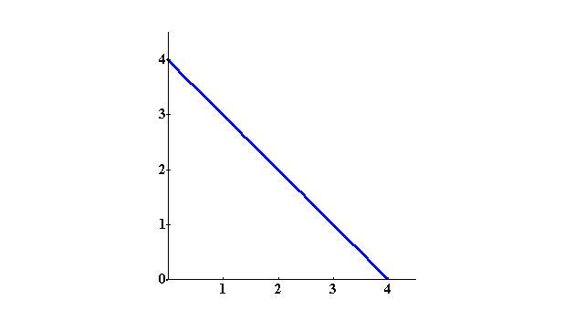
Rational Constrained Choice
x₂
x₁

Slide 4
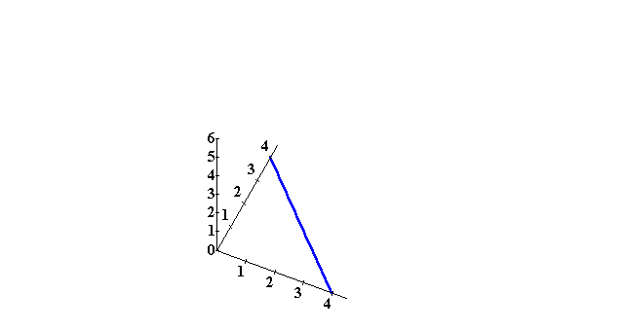
Rational Constrained Choice
Utility
x₂
x₁

Slide 5
Rational Constrained Choice
Utility
x₂
x₁

Slide 6
Rational Constrained Choice
Utility
x₂
x₁

Slide 7
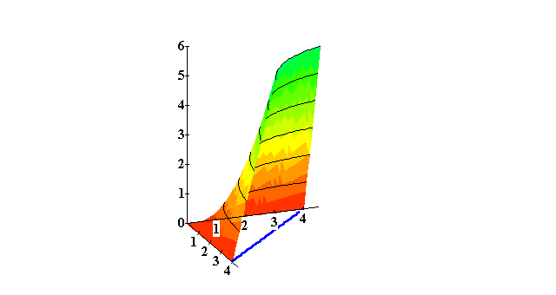
Rational Constrained Choice
Utility
x₂
x₁

Slide 8
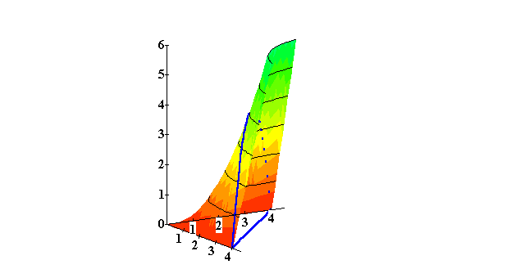
Rational Constrained Choice
Utility
x₂
x₁

Slide 9
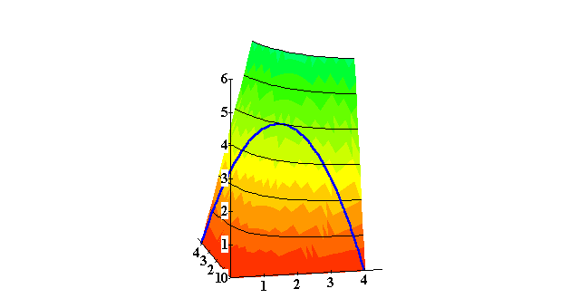
Rational Constrained Choice
Utility
x₂
x₁

Slide 10
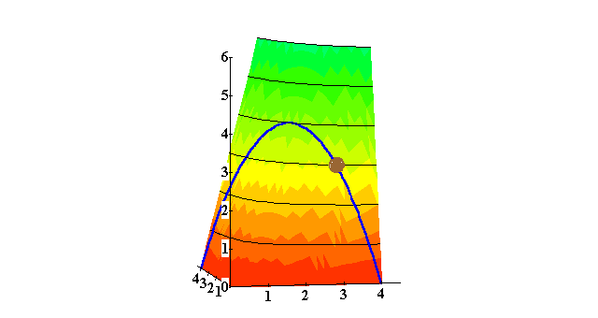
Rational Constrained Choice
Utility
x₂
x₁

Slide 11
Rational Constrained Choice
Utility
Affordable, but not the most preferred affordable bundle.
x₂
x₁

Slide 12
Rational Constrained Choice
Utility
The most preferred of the affordable
bundles.
Affordable, but not the most preferred affordable bundle.
x₂
x₁

Slide 13
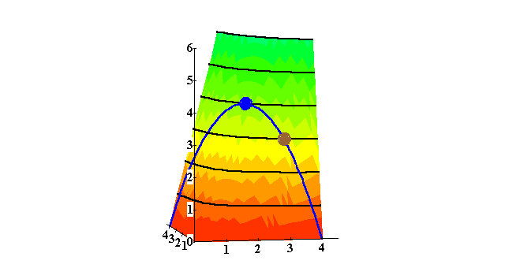
Rational Constrained Choice
Utility
x₂
x₁

Slide 14
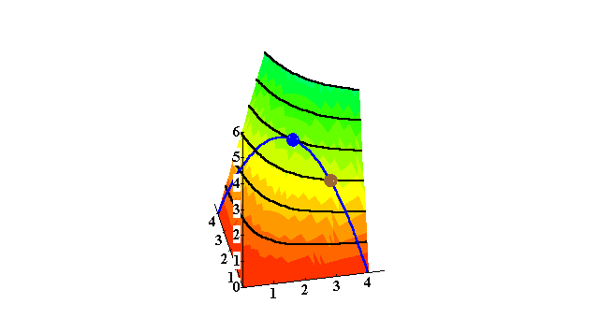
Rational Constrained Choice
Utility
x₂
x₁

Slide 15
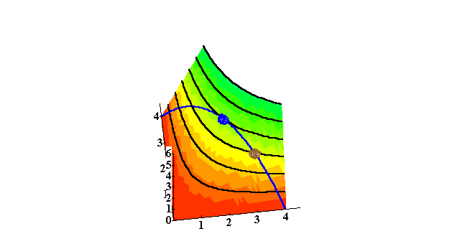
Rational Constrained Choice
x₂
Utility
x₁

Slide 16
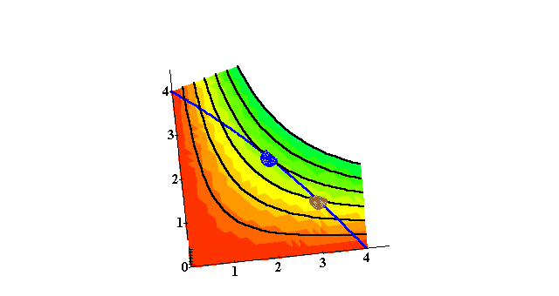
Rational Constrained Choice
x₂
Utility
x₁

Slide 17
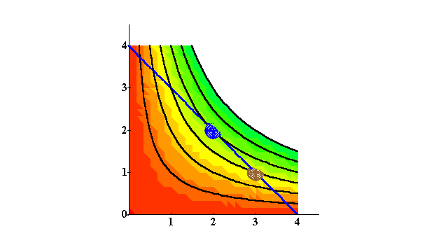
Rational Constrained Choice
x₂
x₁

Slide 18
Rational Constrained Choice
x₂
Affordable bundles
x₁

Slide 19
Rational Constrained Choice
x₂
Affordable bundles
x₁

Slide 20
Rational Constrained Choice
x₂
More preferred bundles
Affordable bundles
x₁

Slide 21
Rational Constrained Choice
x₂
More preferred bundles
Affordable bundles
x₁

Slide 22
Rational Constrained Choice
x₂
x₂*
x₁*
x₁

Slide 23
Rational Constrained Choice
x₂
(x₁*,x₂*) is the most preferred affordable bundle.
x₂*
x₁*
x₁

Slide 24
Rational Constrained Choice
x₂
(x₁*,x₂*) is interior.
(x₁*,x₂*) exhausts the budget.
x₂*
x₁*
x₁

Slide 25
Rational Constrained Choice
x₂
(x₁*,x₂*) is interior . (b) The slope of the indiff. curve at (x₁*,x₂*) equals the slope of the budget constraint.
x₂*
x₁*
x₁

Slide 26
Rational Constrained Choice
(x₁*,x₂*) satisfies two conditions:
(a) the budget is exhausted; p₁x₁* + p₂x₂* = m
(b) the slope of the budget constraint, -p₁/p₂, and the slope of the indifference curve containing (x₁*,x₂*) are equal at (x₁*,x₂*).

