Slide 1
Chapter Four
Utility

Slide 2
Utility Functions & Indiff. Curves
Consider the bundles (4,1), (2,3) and (2,2).
Suppose (2,3) (4,1) ∼ (2,2).
Assign to these bundles any numbers that preserve the preference ordering; e.g. U(2,3) = 6 > U(4,1) = U(2,2) = 4.
Call these numbers utility levels.
p

Slide 3
Utility Functions & Indiff. Curves
An indifference curve contains equally preferred bundles.
Equal preference ⇒ same utility level.
Therefore, all bundles in an indifference curve have the same utility level.

Slide 4
Utility Functions & Indiff. Curves
So the bundles (4,1) and (2,2) are in the indiff. curve with utility level U ≡ 4
But the bundle (2,3) is in the indiff. curve with utility level U ≡ 6.
On an indifference curve diagram, this preference information looks as follows:

Slide 5
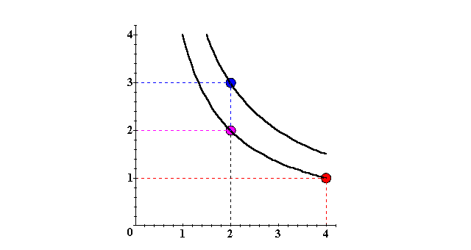
Utility Functions & Indiff. Curves
x₂
(2,3) (2,2) ∼ (4,1)
p
U ≡ 6
U ≡ 4
x₁

Slide 6
Utility Functions & Indiff. Curves
Another way to visualize this same information is to plot the utility level on a vertical axis.

Slide 7
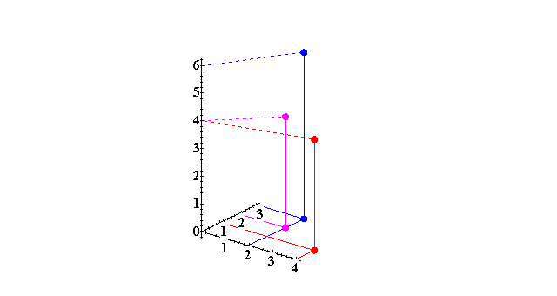
Utility Functions & Indiff. Curves
3D plot of consumption & utility levels for 3 bundles
Utility
U(2,3) = 6
U(2,2) = 4 U(4,1) = 4
x₂
x₁

Slide 8
Utility Functions & Indiff. Curves
This 3D visualization of preferences can be made more informative by adding into it the two indifference curves.

Slide 9
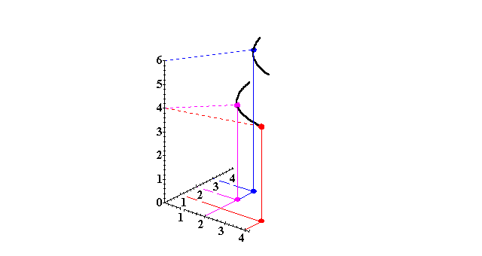
Utility Functions & Indiff. Curves
Utility
U ≡ 6
U ≡ 4
x₂
Higher indifference curves contain
more preferred bundles.
x₁

Slide 10
Utility Functions & Indiff. Curves
Comparing more bundles will create a larger collection of all indifference curves and a better description of the consumer’s preferences.

Slide 11
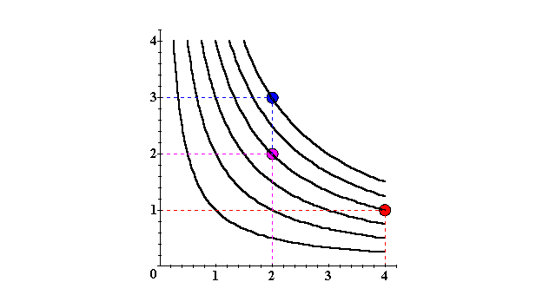
Utility Functions & Indiff. Curves
x₂
U ≡ 6
U ≡ 4
U ≡ 2
x₁

Slide 12
Utility Functions & Indiff. Curves
As before, this can be visualized in 3D by plotting each indifference curve at the height of its utility index.

Slide 13
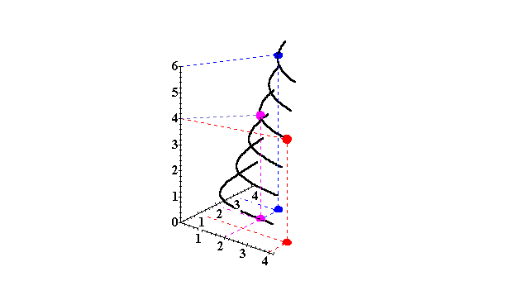
Utility Functions & Indiff. Curves
Utility
U ≡ 6
U ≡ 5
U ≡ 4
x₂
U ≡ 3
U ≡ 2
U ≡ 1
x₁

Slide 14
Utility Functions & Indiff. Curves
Comparing all possible consumption bundles gives the complete collection of the consumer’s indifference curves, each with its assigned utility level.
This complete collection of indifference curves completely represents the consumer’s preferences.

Slide 15
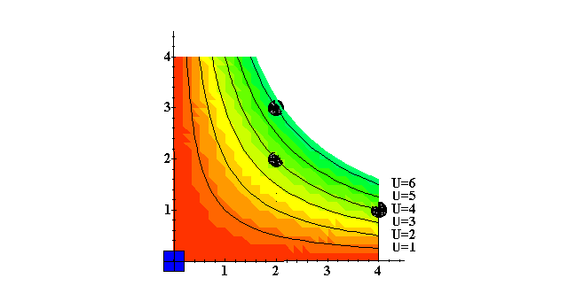
Utility Functions & Indiff. Curves
x₂
x₁

Slide 16
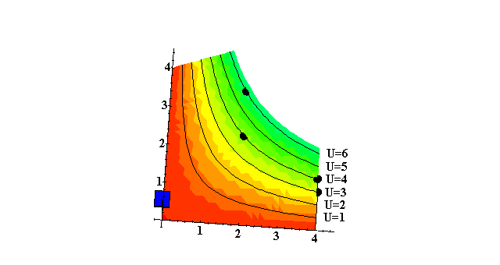
Utility Functions & Indiff. Curves
x₂
x₁

Slide 17
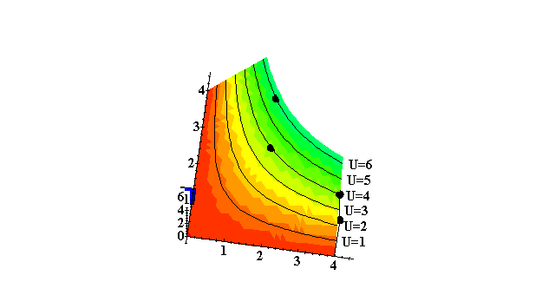
Utility Functions & Indiff. Curves
x₂
x₁

Slide 18
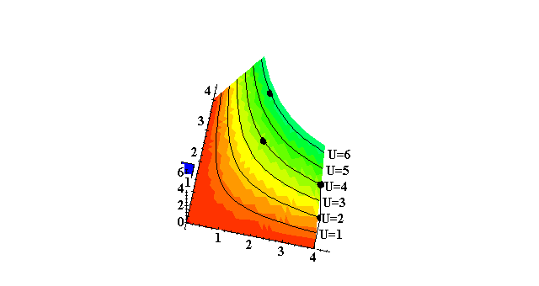
Utility Functions & Indiff. Curves
x₂
x₁

Slide 19
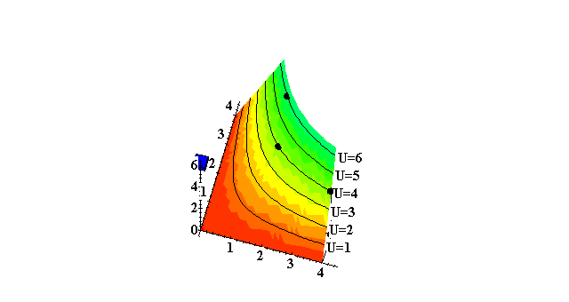
Utility Functions & Indiff. Curves
x₂
x₁

Slide 20
Utility Functions & Indiff. Curves
x₂
x₁

Slide 21
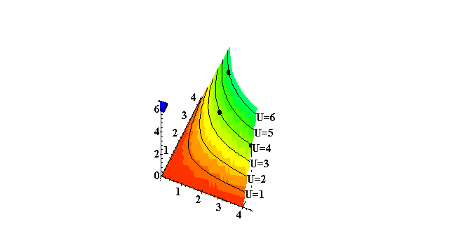
Utility Functions & Indiff. Curves
x₁

Slide 22
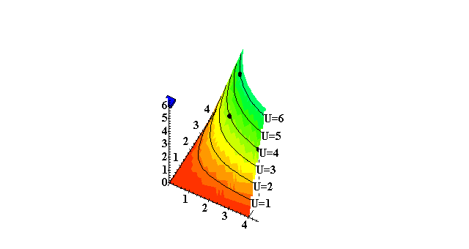
Utility Functions & Indiff. Curves
x₁

Slide 23
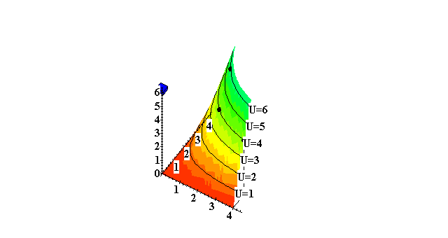
Utility Functions & Indiff. Curves
x₁

Slide 24
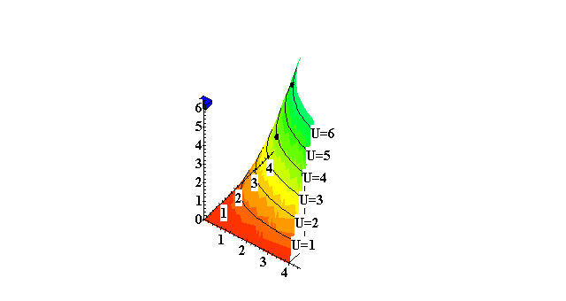
Utility Functions & Indiff. Curves
x₁

Slide 25
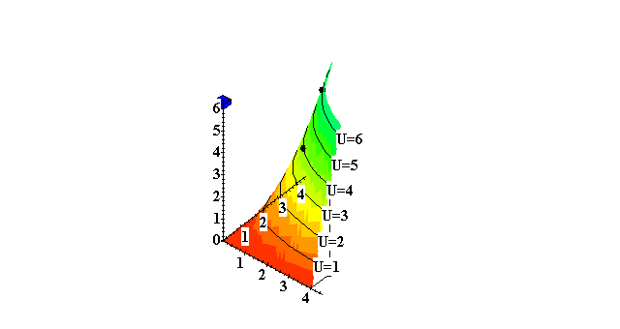
Utility Functions & Indiff. Curves
x₁

Slide 26
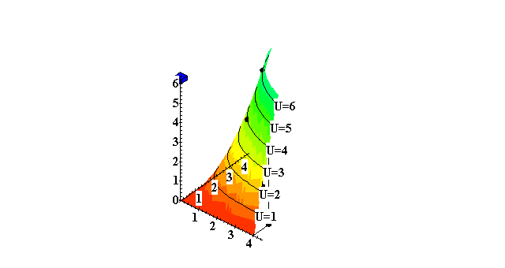
Utility Functions & Indiff. Curves
x₁

Slide 27
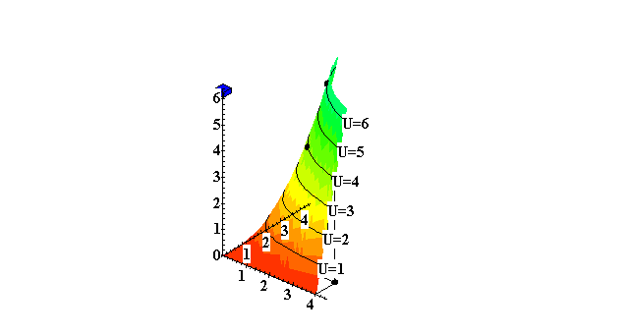
Utility Functions & Indiff. Curves
x₁

Slide 28
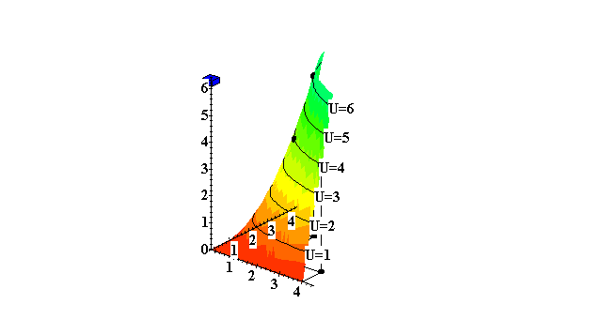
Utility Functions & Indiff. Curves
x₁

Slide 29
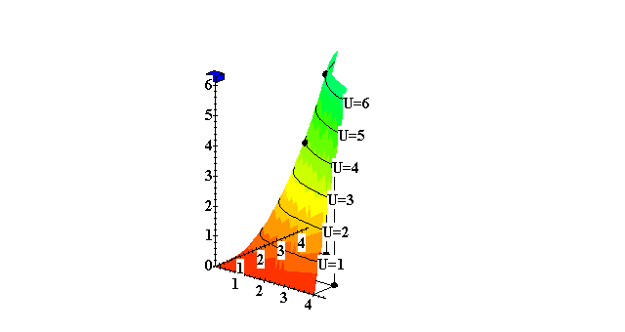
Utility Functions & Indiff. Curves
x₁

Slide 30
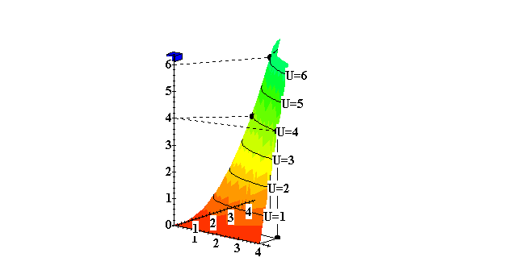
Utility Functions & Indiff. Curves
x₁

